Slide 1
the Houston Museum of American Art
Chang Liu | Lighting + Electrical | Final Thesis Presentation| 4.26. 2013

Slide 2
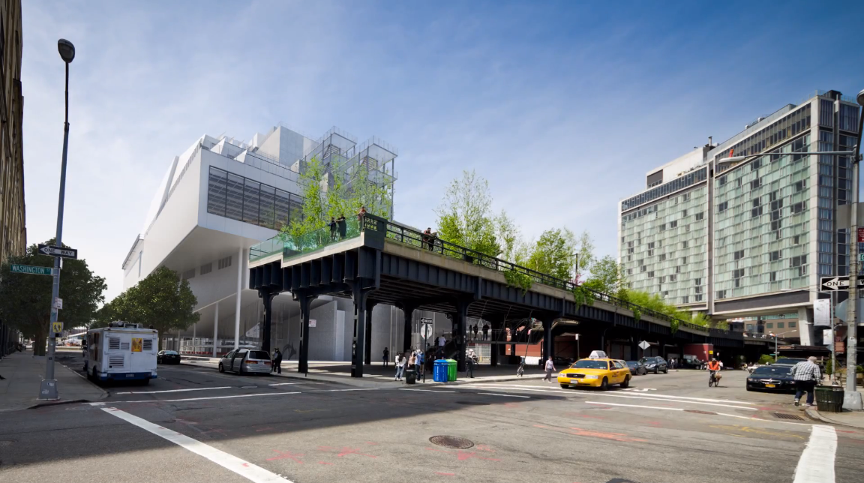
5
… special thanks to
Summary + acknowledgements + questions
WELCOME TO THE HOUSTON MUSEUM OF AMERICAN ART
4
Electrical Depth
System type conversion + Cogeneration
3
8th floor gallery
Large workspace + daylighting
Since 1930, the Houston has championed groundbreaking American art. The museum’s founder believed in supporting living artists, from celebrated pioneers to the latest innovators. We continue this tradition by presenting a mix of special exhibitions and installations of works from our collection.
We hope you enjoy your visit.
2
Theater
Special purpose space
1
Building facade
Scale of perception + Exterior space
LG
Houston Museum of American Art
Project overview + design concept

Slide 3
5
… special thanks to
Summary + acknowledgements + questions
LIGHTING DEPTH
ELECTRICAL DEPTH
BREADTH STUDY
4
Building façade
Main lobby
Theater
8th floor gallery
System type conversion study
Wire upsizing
Daylighting
Cogeneration feasibility study
Acoustics assessment
Social concepts
Electrical Depth
System type conversion + Cogeneration
3
8th floor gallery
Large workspace + daylighting
2
Design Scope
Theater
Special purpose space
1
Building facade
Scale of perception + Exterior space
LG
Houston Museum of American Art
Project overview + design concept

Slide 4
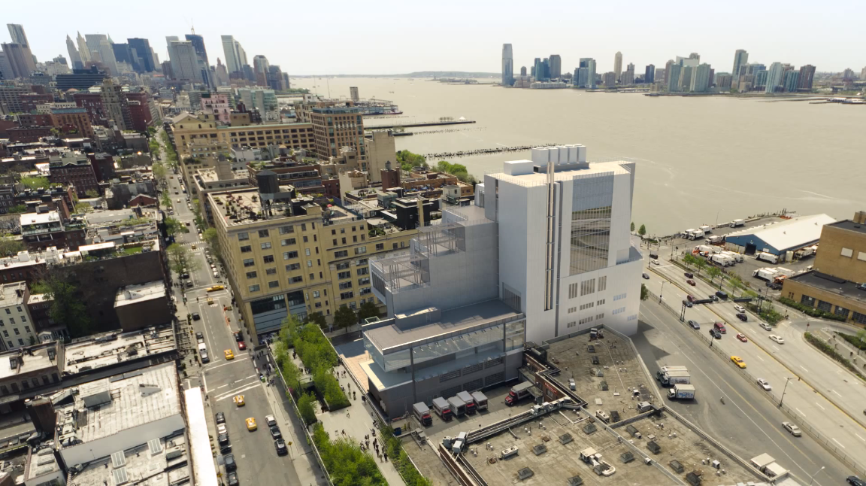
5
… special thanks to
Summary + acknowledgements + questions
Statistics
4
Name:
Location:
Size:
Levels:
the Houston Museum of American Art
New York, New York
222,952 SF
9 stories above grade
Electrical Depth
System type conversion + Cogeneration
3
8th floor gallery
Large workspace + daylighting
2
Theater
Special purpose space
Project Team
Design Architect:
Executive Architect:
MEP Engineer:
Lighting Designer:
Construction Manager:
Renzo Piano Building Workshop
Cooper, Robertson & Partners
Jaros, Baum & Bolles
Ove Arup & Partners
Turner Construction, LLC
1
Building facade
Scale of perception + Exterior space
LG
Houston Museum of American Art
Project overview + design concept

Slide 5
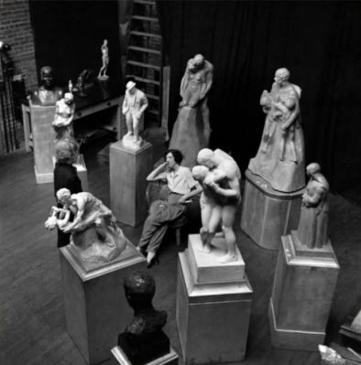
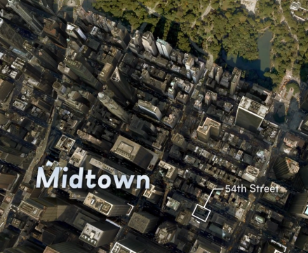
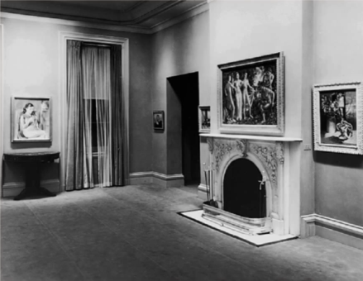
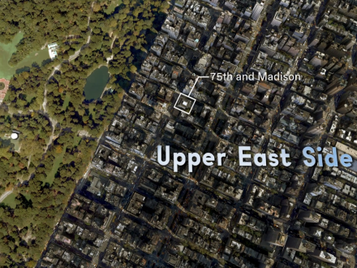
5
… special thanks to
Summary + acknowledgements + questions
4
Electrical Depth
System type conversion + Cogeneration
3
8th floor gallery
Large workspace + daylighting
Houston Museum of American Art
established
1931
Moved to 75th street
1966
2
Theater
Special purpose space
1914
Houston Studio Club established
1954
moved to 54th street
2015
future Houston Museum of American Art
at the Meatpacking district
1
Building facade
Scale of perception + Exterior space
LG
Houston Museum of American Art
Project overview + design concept

Slide 6
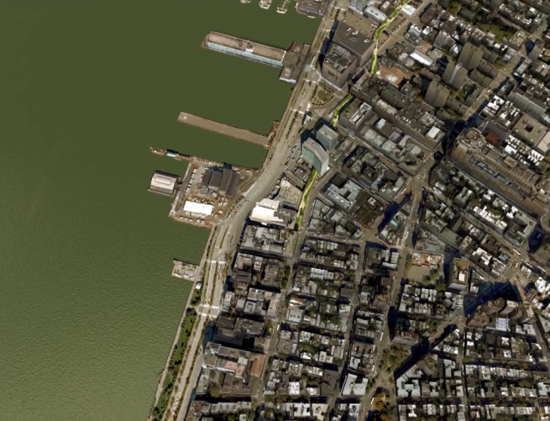
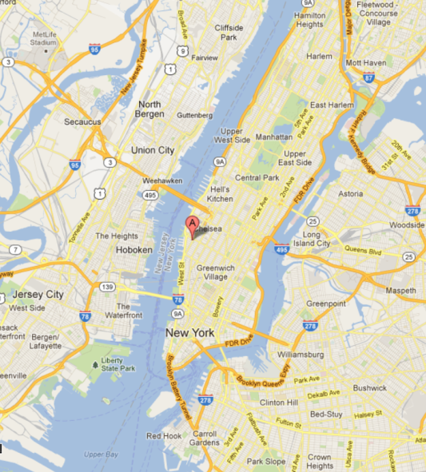
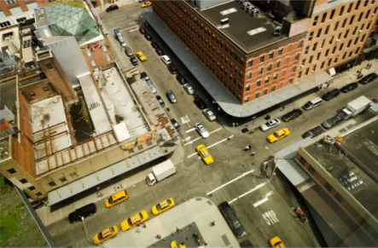
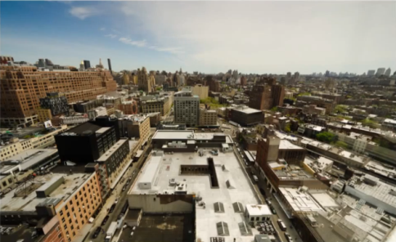
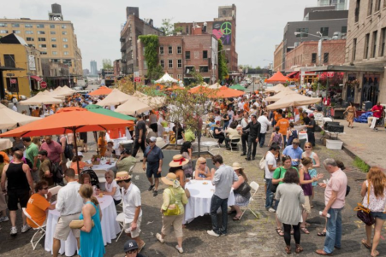
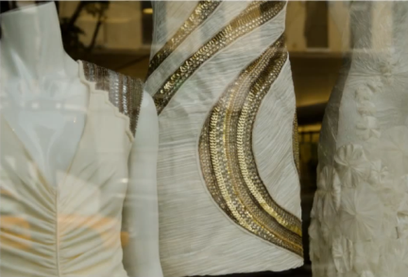
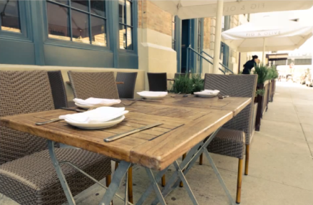
5
… special thanks to
Summary + acknowledgements + questions
4
Electrical Depth
System type conversion + Cogeneration
N
3
8th floor gallery
Large workspace + daylighting
Manhattan
High Line
the Houston
2
Theater
Special purpose space
1
Building facade
Scale of perception + Exterior space
LG
Houston Museum of American Art
Project overview + design concept

Slide 7
5
… special thanks to
Summary + acknowledgements + questions
4
Electrical Depth
System type conversion + Cogeneration
“The museum will be a dynamic new presence downtown … as a vital resource that engages the neighborhood, enlivens the cultural dialogue, and welcomes the people of New York and beyond.”
- Neil G. Bluhm, president of the Board of Trustees
3
8th floor gallery
Large workspace + daylighting
2
Theater
Special purpose space
The future Houston is designed to embrace and reciprocate the energy of the neighborhood and provide a stimulating and immersive space in which to experience art.
- Renzo Piano
1
Building facade
Scale of perception + Exterior space
LG
Houston Museum of American Art
Project overview + design concept

Slide 8
5
… special thanks to
Summary + acknowledgements + questions
4
dynamic
Electrical Depth
System type conversion + Cogeneration
“The museum will be a dynamic new presence downtown … as a vital resource that engages the neighborhood, enlivens the cultural dialogue, and welcomes the people of New York and beyond.”
- Neil G. Bluhm, president of the Board of Trustees
welcoming
3
enlivening
8th floor gallery
Large workspace + daylighting
engaging
2
Theater
Special purpose space
energetic
The future Houston is designed to embrace and reciprocate the energy of the neighborhood and provide a stimulating and immersive space in which to experience art.
- Renzo Piano
1
Building facade
Scale of perception + Exterior space
stimulating
immersive
LG
Houston Museum of American Art
Project overview + design concept

Slide 9
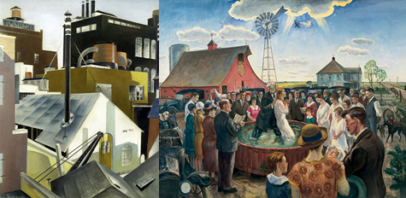
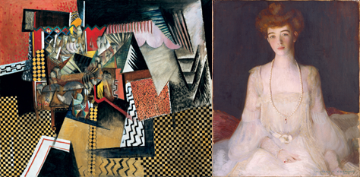
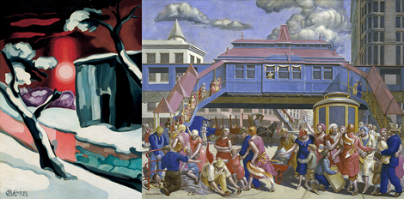
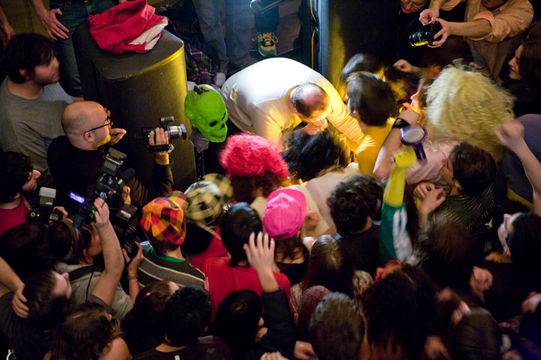
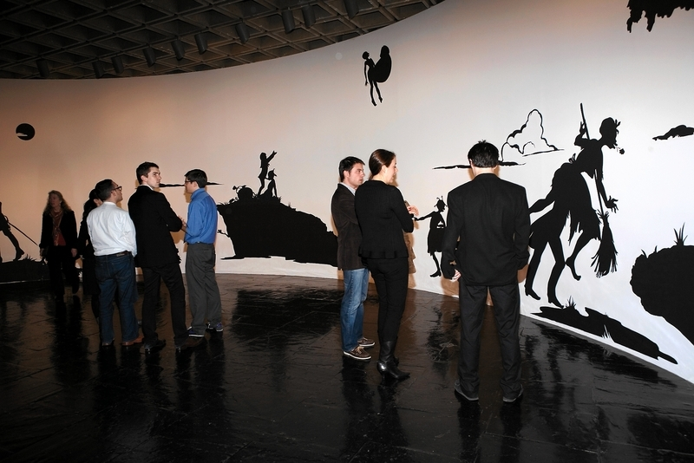
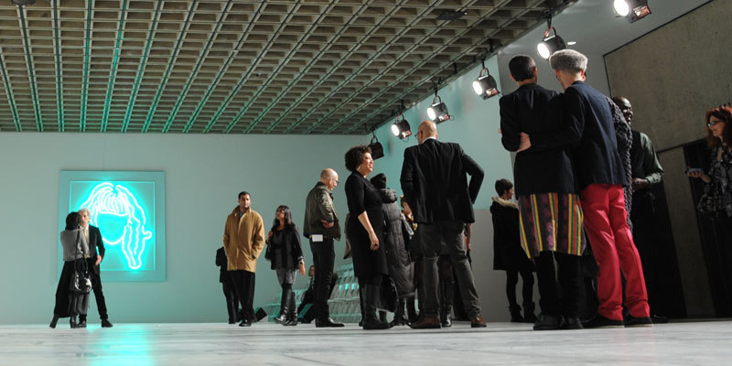
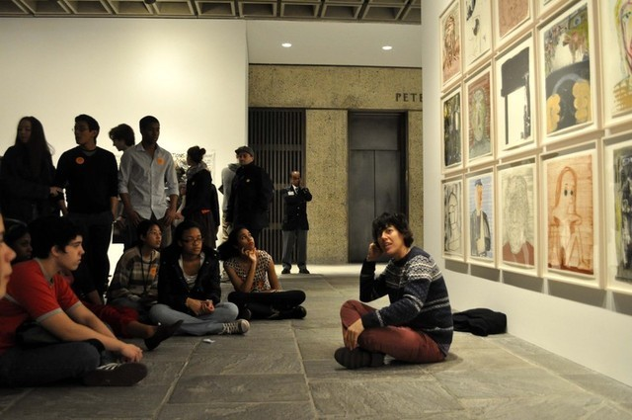
5
… special thanks to
Summary + acknowledgements + questions
4
Electrical Depth
System type conversion + Cogeneration
ART
3
8th floor gallery
Large workspace + daylighting
2
NEIGHBORHOOD
engaging
Lighting Depth
Theater
Special purpose space
1
Building facade
Scale of perception + Exterior space
PEOPLE
LG
Houston Museum of American Art
Project overview + design concept

Slide 10
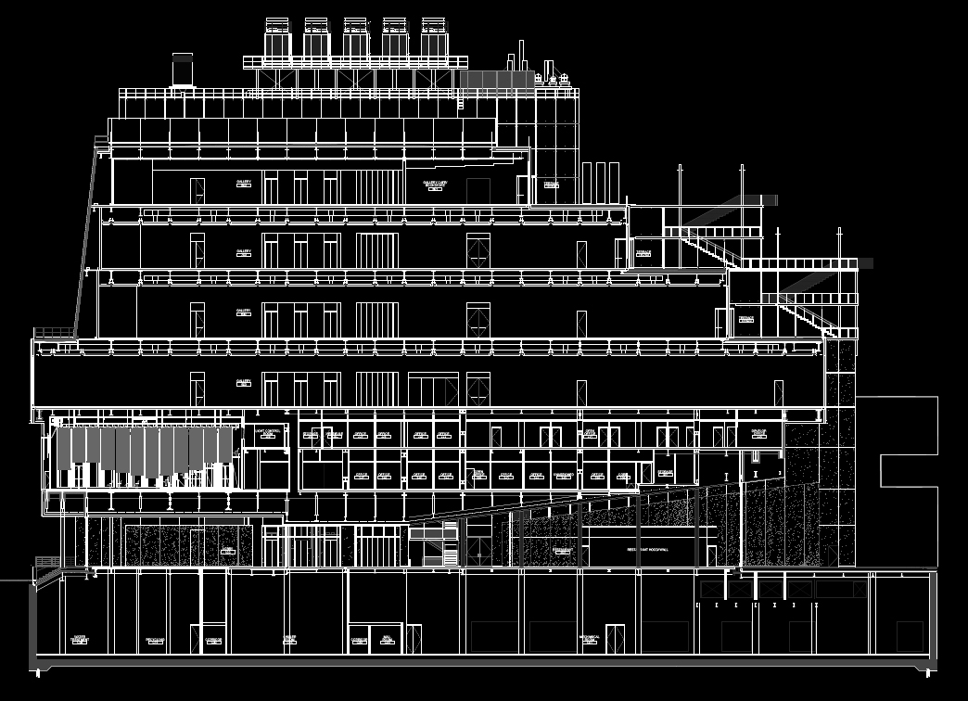
5
… special thanks to
Summary + acknowledgements + questions
4
Electrical Depth
System type conversion + Cogeneration
3
GALLERY
8th floor gallery
Large workspace + daylighting
FACADE
2
Lighting Depth
Theater
Special purpose space
THEATER
1
Building facade
Scale of perception + Exterior space
LG
Houston Museum of American Art
Project overview + design concept

Slide 11
5
… special thanks to
Summary + acknowledgements + questions
4
Electrical Depth
System type conversion + Cogeneration
3
8th floor gallery
Large workspace + daylighting
2
Building Facade
Theater
Special purpose space
1
Building facade
Scale of perception + Exterior space
LG
Houston Museum of American Art
Project overview + design concept
Notes:
The last but not least social concept studied is mentioned in Jan Gehl’s book Cities for People, that the quality of a city space is directly related to its degree of concern for the human dimension.
The social field of vision was investigated by Gehl to study the relationship between the senses, communication and dimensions. According to Gehl, our sense of sight has adapted and developed to enable us to move linearly and horizontally at a walking. Earlier in our history it was important for walkers to be able to detect dangers and enemies lurking ahead, and on the path in front of them. It was also crucial to be able to keep an eye on what was happening on both sides of the path. As a result, our eyes can see clearly and precisely straight ahead and at a great distance. Furthermore, the rods and cones in the photoreceptor layer of the eye are organized primarily horizontally, enabling use to see movement further out in the field of vision, perpendicular to the walking direction. However, our downward and upward sight has developed very differently. Looking down where it is important to see what we are stepping on, we humans can see up to 70-80 degrees below the horizon. Upwards, where in the later phases of evolutionary history we had only few enemies to beware of, the angle of vision is limited to 50-55 degrees above the horizon. Our horizontal field of visions means that when we are walking along building facades, only the ground floors can offer us interest and intensity. If ground floor facades are rich in variation and detail, our city walks will be equally rich in experience.
Since our senses and locomotors apparatus has only a limited field of upward vision, this whole account of the horizontal sensory apparatus is the key to how we experience space, for example, how much of buildings pedestrians experience when walking along streets. In general, the upper floors of tall buildings can only be seen at a distance and never close up in the cityscape.
At eye level the scene comes alive with movement and color. While the designer sees the whole building – the clean verticals, the horizontals, the way corner turns, and so on. But the museum visitors may be quite unaware of such matters. He is more apt to be looking in the other direction: not up at other buildings, but at what is going on at eye level or his handling of space.
To create a close-up experience for the visitors, a lighting approach will need to bring all the senses to bear. Every effort is made to keep the dimensions and design of outdoor space in harmony with the human scale and comfortable perception range.

Slide 12
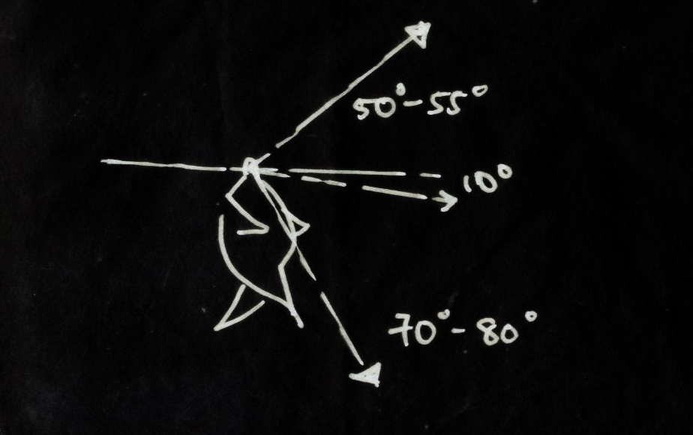
5
… special thanks to
Summary + acknowledgements + questions
4
Electrical Depth
System type conversion + Cogeneration
3
8th floor gallery
Large workspace + daylighting
2
How much of a building do pedestrians experience when walking along streets?
Theater
Special purpose space
Comfortable view range
1
Building facade
Scale of perception + Exterior space
LG
Houston Museum of American Art
Project overview + design concept
Notes:
The last but not least social concept studied is mentioned in Jan Gehl’s book Cities for People, that the quality of a city space is directly related to its degree of concern for the human dimension.
The social field of vision was investigated by Gehl to study the relationship between the senses, communication and dimensions. According to Gehl, our sense of sight has adapted and developed to enable us to move linearly and horizontally at a walking. Earlier in our history it was important for walkers to be able to detect dangers and enemies lurking ahead, and on the path in front of them. It was also crucial to be able to keep an eye on what was happening on both sides of the path. As a result, our eyes can see clearly and precisely straight ahead and at a great distance. Furthermore, the rods and cones in the photoreceptor layer of the eye are organized primarily horizontally, enabling use to see movement further out in the field of vision, perpendicular to the walking direction. However, our downward and upward sight has developed very differently. Looking down where it is important to see what we are stepping on, we humans can see up to 70-80 degrees below the horizon. Upwards, where in the later phases of evolutionary history we had only few enemies to beware of, the angle of vision is limited to 50-55 degrees above the horizon. Our horizontal field of visions means that when we are walking along building facades, only the ground floors can offer us interest and intensity. If ground floor facades are rich in variation and detail, our city walks will be equally rich in experience.
Since our senses and locomotors apparatus has only a limited field of upward vision, this whole account of the horizontal sensory apparatus is the key to how we experience space, for example, how much of buildings pedestrians experience when walking along streets. In general, the upper floors of tall buildings can only be seen at a distance and never close up in the cityscape.
At eye level the scene comes alive with movement and color. While the designer sees the whole building – the clean verticals, the horizontals, the way corner turns, and so on. But the museum visitors may be quite unaware of such matters. He is more apt to be looking in the other direction: not up at other buildings, but at what is going on at eye level or his handling of space.
To create a close-up experience for the visitors, a lighting approach will need to bring all the senses to bear. Every effort is made to keep the dimensions and design of outdoor space in harmony with the human scale and comfortable perception range.

Slide 13
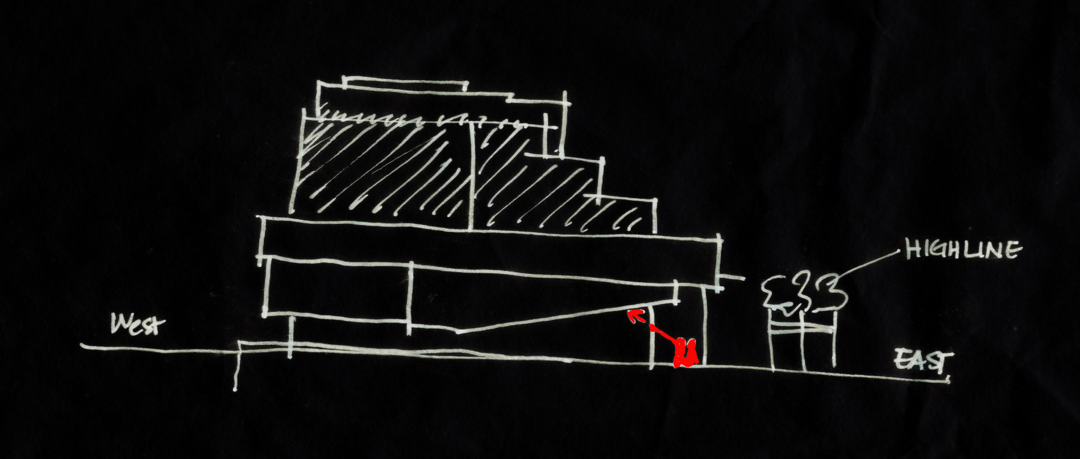
5
… special thanks to
Summary + acknowledgements + questions
4
Electrical Depth
System type conversion + Cogeneration
3
8th floor gallery
Large workspace + daylighting
The upper floors of buildings can only be seen at a distance and never close-up in the city scape
2
Theater
Special purpose space
1
Building facade
Scale of perception + Exterior space
LG
South elevation
Houston Museum of American Art
Project overview + design concept
Notes:
The last but not least social concept studied is mentioned in Jan Gehl’s book Cities for People, that the quality of a city space is directly related to its degree of concern for the human dimension.
The social field of vision was investigated by Gehl to study the relationship between the senses, communication and dimensions. According to Gehl, our sense of sight has adapted and developed to enable us to move linearly and horizontally at a walking. Earlier in our history it was important for walkers to be able to detect dangers and enemies lurking ahead, and on the path in front of them. It was also crucial to be able to keep an eye on what was happening on both sides of the path. As a result, our eyes can see clearly and precisely straight ahead and at a great distance. Furthermore, the rods and cones in the photoreceptor layer of the eye are organized primarily horizontally, enabling use to see movement further out in the field of vision, perpendicular to the walking direction. However, our downward and upward sight has developed very differently. Looking down where it is important to see what we are stepping on, we humans can see up to 70-80 degrees below the horizon. Upwards, where in the later phases of evolutionary history we had only few enemies to beware of, the angle of vision is limited to 50-55 degrees above the horizon. Our horizontal field of visions means that when we are walking along building facades, only the ground floors can offer us interest and intensity. If ground floor facades are rich in variation and detail, our city walks will be equally rich in experience.
Since our senses and locomotors apparatus has only a limited field of upward vision, this whole account of the horizontal sensory apparatus is the key to how we experience space, for example, how much of buildings pedestrians experience when walking along streets. In general, the upper floors of tall buildings can only be seen at a distance and never close up in the cityscape.
At eye level the scene comes alive with movement and color. While the designer sees the whole building – the clean verticals, the horizontals, the way corner turns, and so on. But the museum visitors may be quite unaware of such matters. He is more apt to be looking in the other direction: not up at other buildings, but at what is going on at eye level or his handling of space.
To create a close-up experience for the visitors, a lighting approach will need to bring all the senses to bear. Every effort is made to keep the dimensions and design of outdoor space in harmony with the human scale and comfortable perception range.

Slide 14
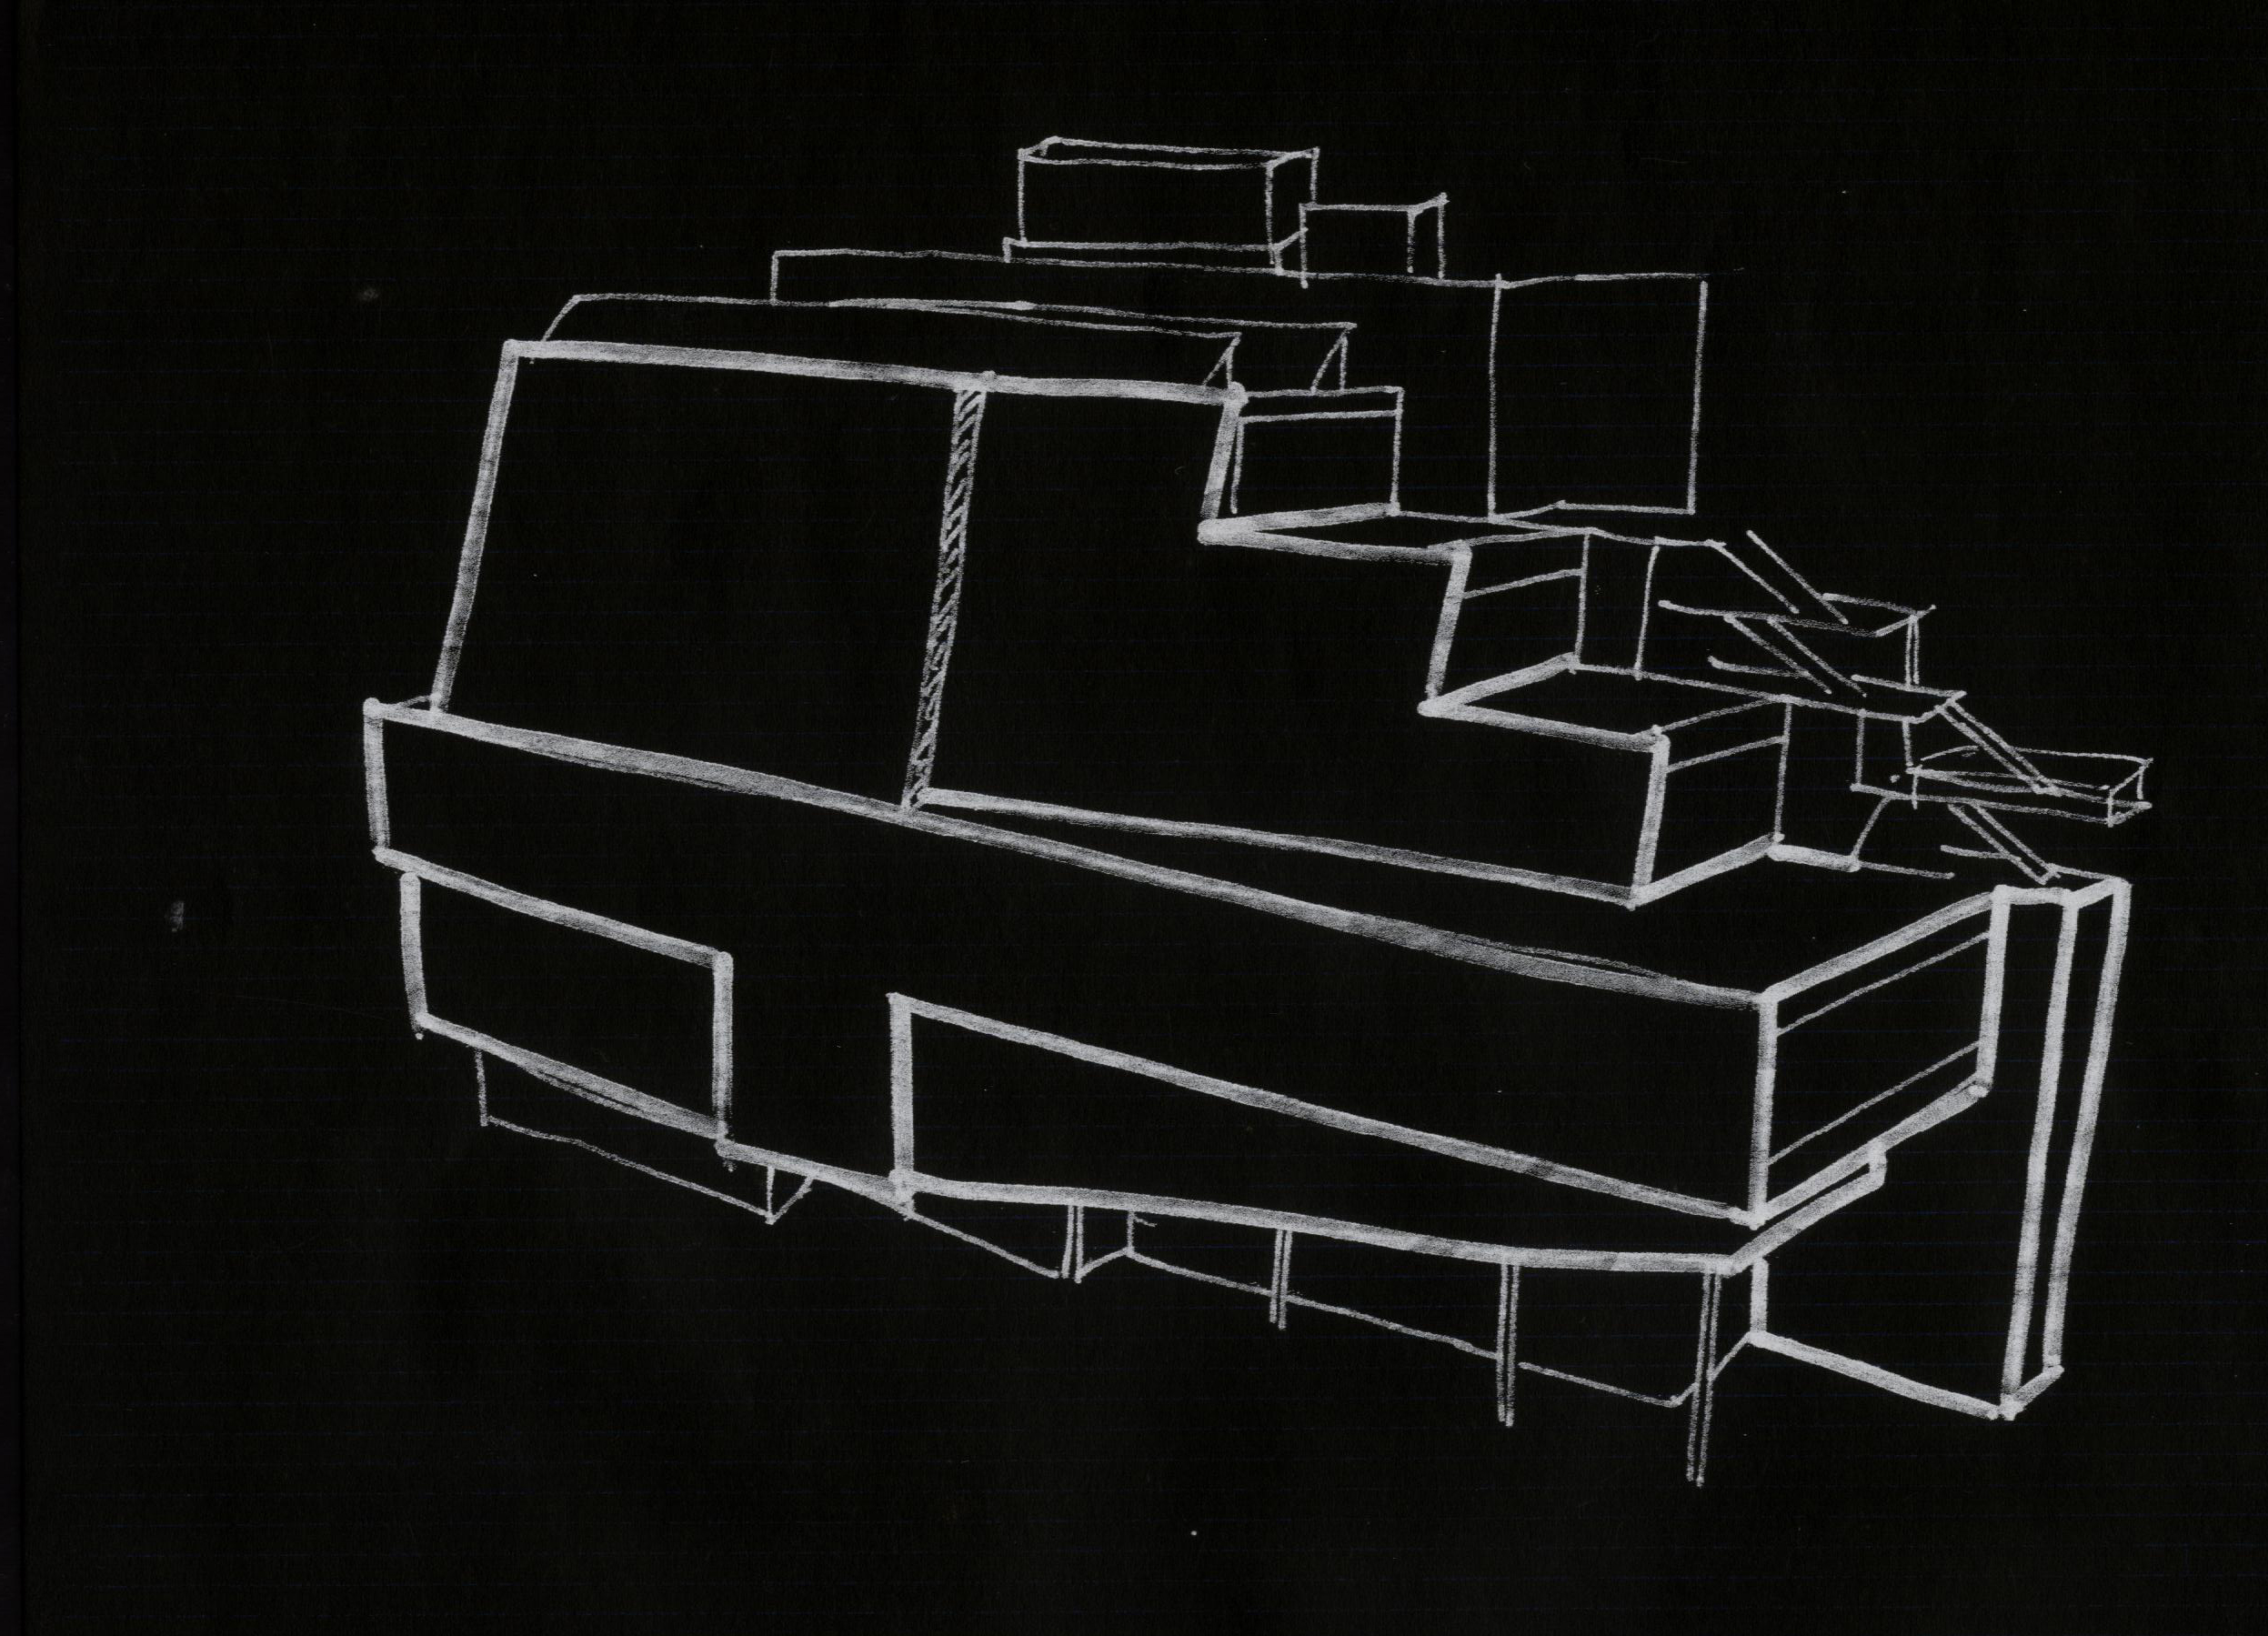
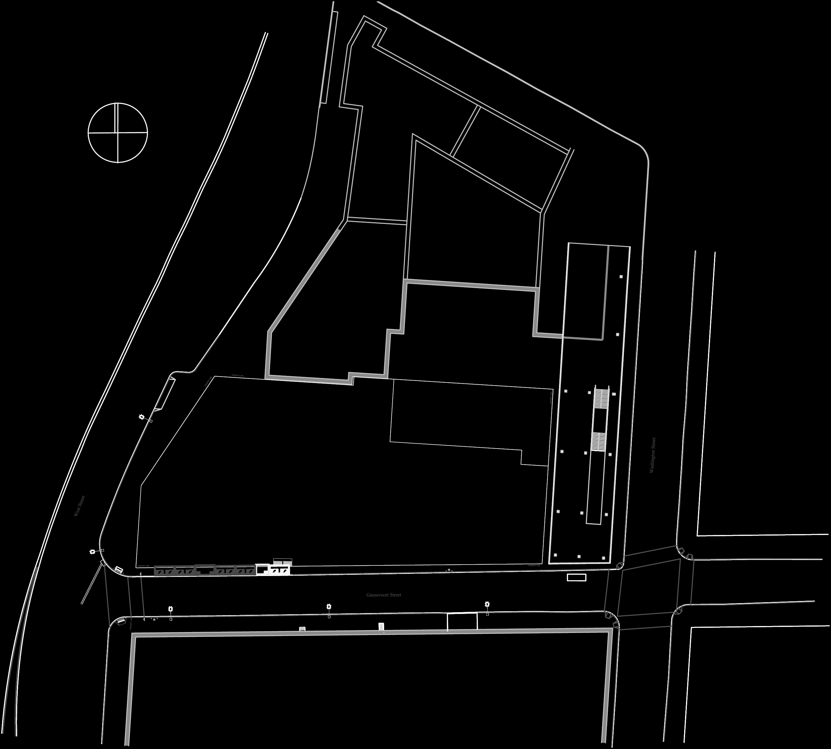
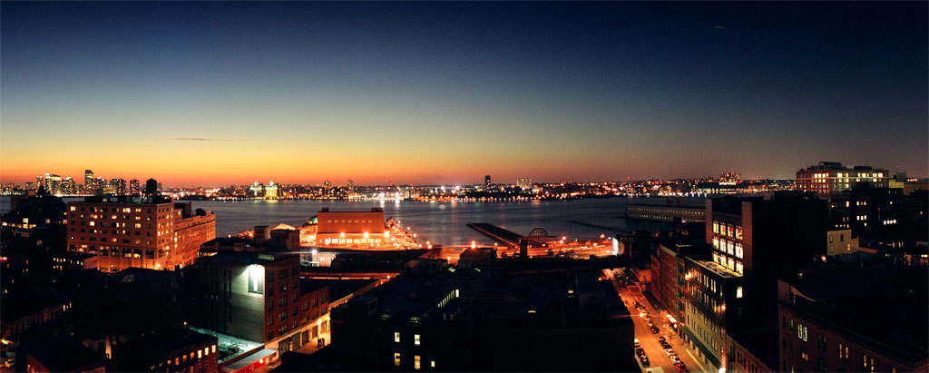
5
… special thanks to
Summary + acknowledgements + questions
4
Electrical Depth
System type conversion + Cogeneration
Cream colored steel plate cladding
3
Cable-wall glazing
8th floor gallery
Large workspace + daylighting
Pre-cast concrete
2
Theater
Special purpose space
1
Building facade
Scale of perception + Exterior space
LG
South facade
Houston Museum of American Art
Project overview + design concept
Notes:
The lighting redesign for the building façade is thoroughly investigated before implementation. Situated in the city that never sleeps where extravagant lighting is everywhere, the Houston Museum’s light design has a more elegant and subtle take that is oriented toward the public experiences. The overall goal of engaging the people through an element of construction that is not touchable is achieved. The central idea of “people, building, city – in that order” presents itself through the lighting design.
The design approach was realized through different lighting element. The activation of the north façade is through the silhouette produced by the interior light and the surrounding lighting with the city as the back drop. Not only were the cream-color façade plates able to catch the natural light, they were perfect mirror of what’s going on around the Houston. Thus the building will reflect a decent amount of light from other buildings around.
The south façade was lit with the emphasis of human scale. Instead of using large luminaires and lighting design that focus on the form of large units that removed life from the streets, more intimate luminaires were implemented. Additionally, to blend into the surrounding, the lighting design is subtle and simple. The outset goals were achieved. Additionally, the illuminance levels meet those specified in the IESNA handbook.

Slide 15
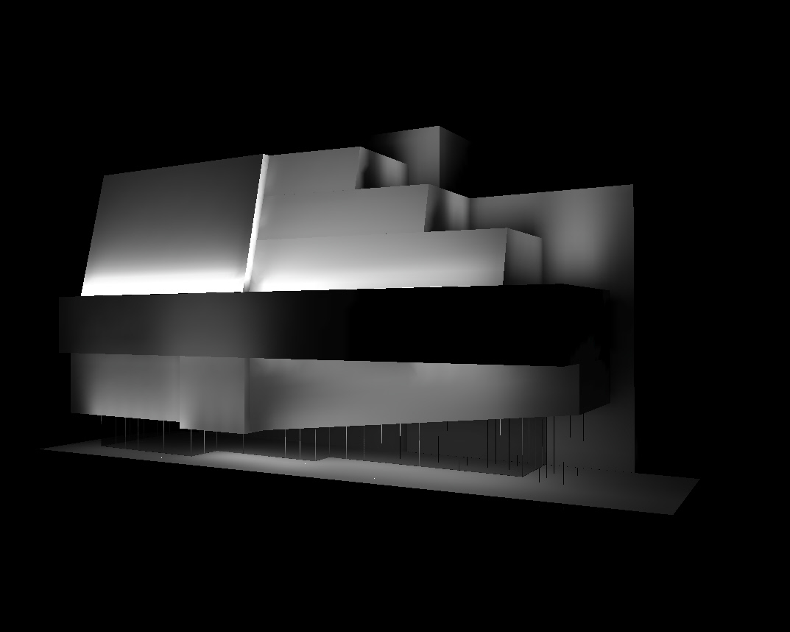
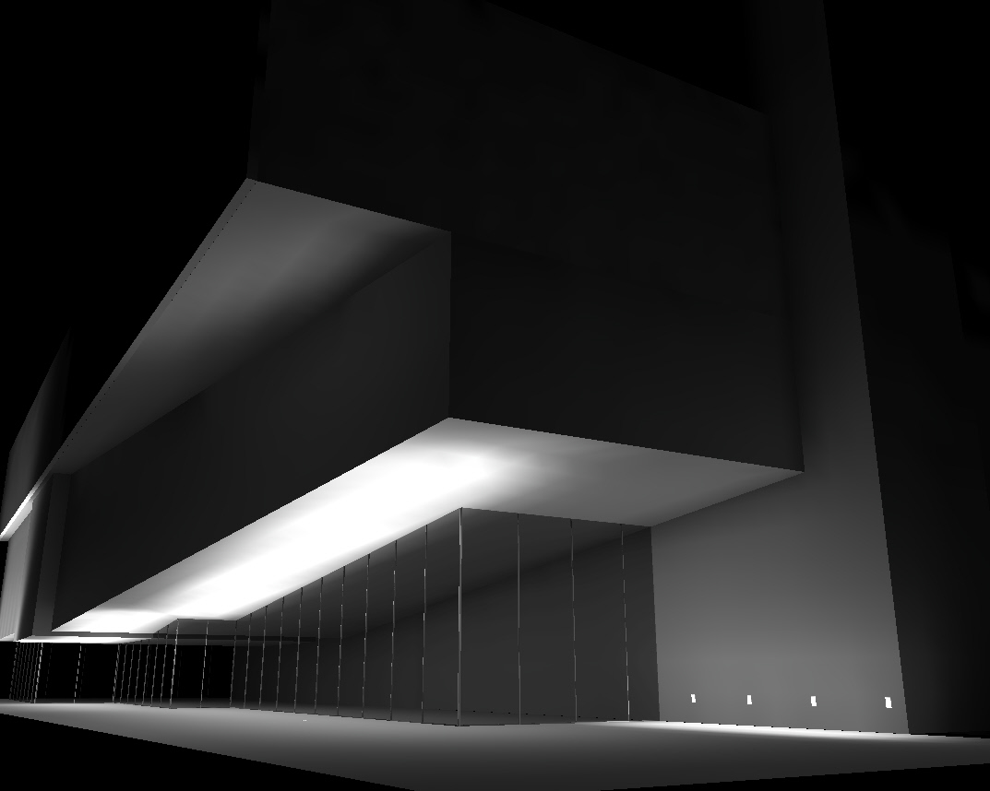
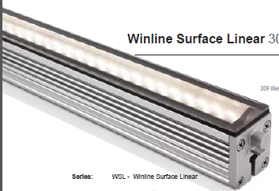
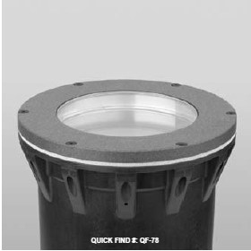
5
… special thanks to
Summary + acknowledgements + questions
4
Electrical Depth
System type conversion + Cogeneration
3
8th floor gallery
Large workspace + daylighting
2
Theater
Special purpose space
1
Building facade
Scale of perception + Exterior space
LG
Houston Museum of American Art
Project overview + design concept

Slide 16
5
… special thanks to
Summary + acknowledgements + questions
4
Electrical Depth
System type conversion + Cogeneration
3
8th floor gallery
Large workspace + daylighting
2
Theater
Theater
Special purpose space
1
Building facade
Scale of perception + Exterior space
LG
Houston Museum of American Art
Project overview + design concept

Slide 17
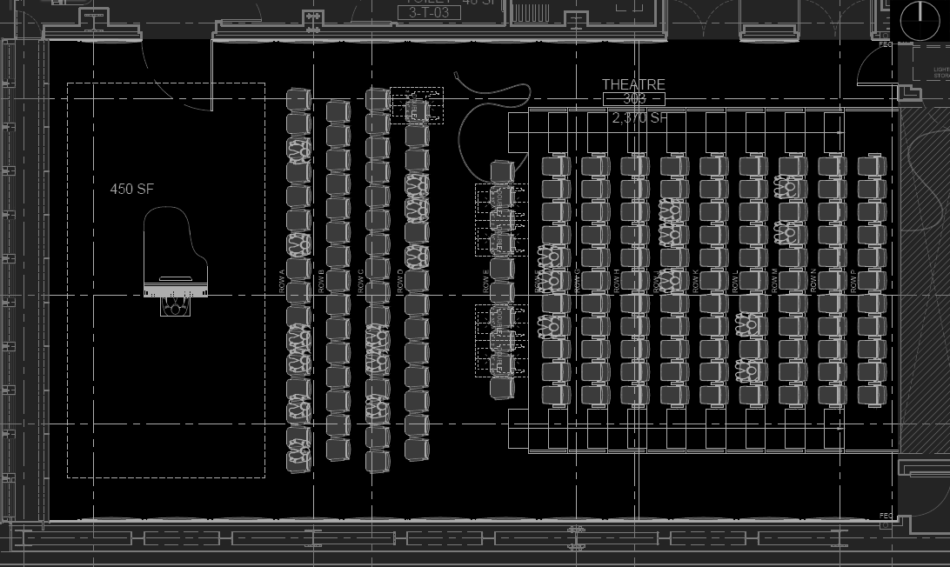
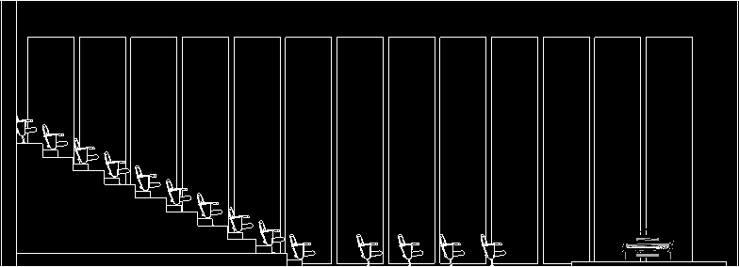
5
… special thanks to
Summary + acknowledgements + questions
4
Electrical Depth
System type conversion + Cogeneration
Plywood panel
3
Acoustical ceiling panel
8th floor gallery
Large workspace + daylighting
Yellow pine flooring
2
multi-media presentations motion picture films lectures podium discussions rentable for outside parties performances screening of new artwork
Theater
Special purpose space
1
Building facade
Scale of perception + Exterior space
LG
Houston Museum of American Art
Project overview + design concept
Notes:
The black box theater located on the third floor is designed to be used for multi-media presentations, motion picture films, lectures, podium discussions, performances, screening of new artwork, and it can also be rented for outside parties.
The lighting design in this space explores the idea of coverage vs. flexibility. For the extreme variable purpose and activities that will be going on in this room, a very flexible lighting system can be essential. However exactly how flexible does the system needs is raised, can coverage give you flexibility without over complicate the system. Another important consideration for the space is unlike any other spaces in the building, theater is a place where people will most likely need to wait for the show to start and observe the architecture not necessarily intentionally. So simplicity needs to be fused with drama. The concept offers a great opportunity for the lighting design to shine, to tap the underlying architectural features and at the same time, not losing touch to the museum, to its neighborhood, and to the melancholic, unruly beauty of the high line. To ensure the coverage, adjustable mono-points are recessed into the ceiling. A track system inspired by the rail tracks and the patterns of railroad switch is proposed. The track is to provide spotlighting possibilities of the space.

Slide 18
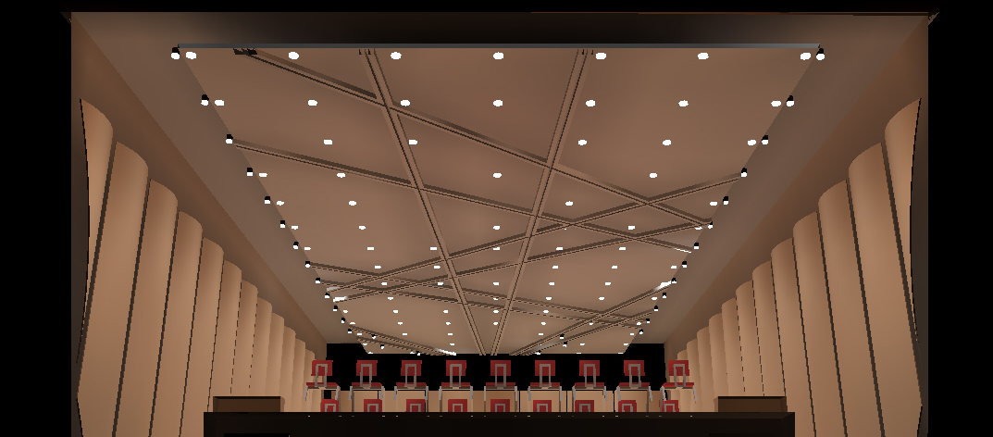
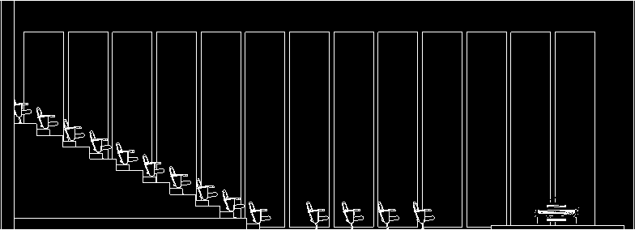
5
… special thanks to
Summary + acknowledgements + questions
4
Electrical Depth
System type conversion + Cogeneration
3
8th floor gallery
Large workspace + daylighting
2
+
+
Theater
Special purpose space
1
Building facade
Scale of perception + Exterior space
LG
Houston Museum of American Art
Project overview + design concept
Notes:
Will coverage provide flexibility?

Slide 19
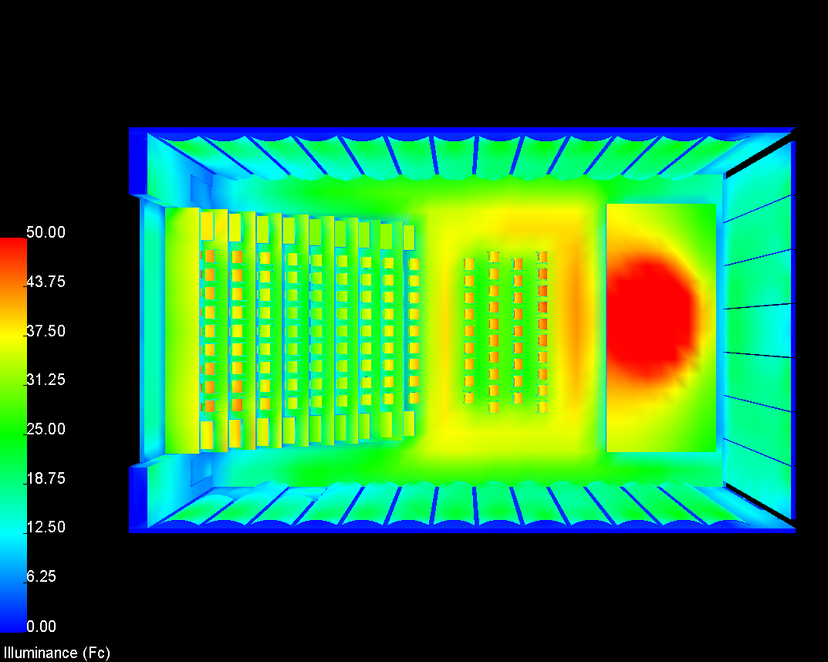
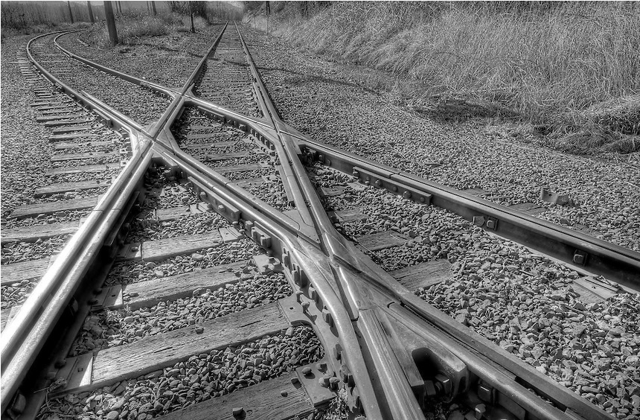
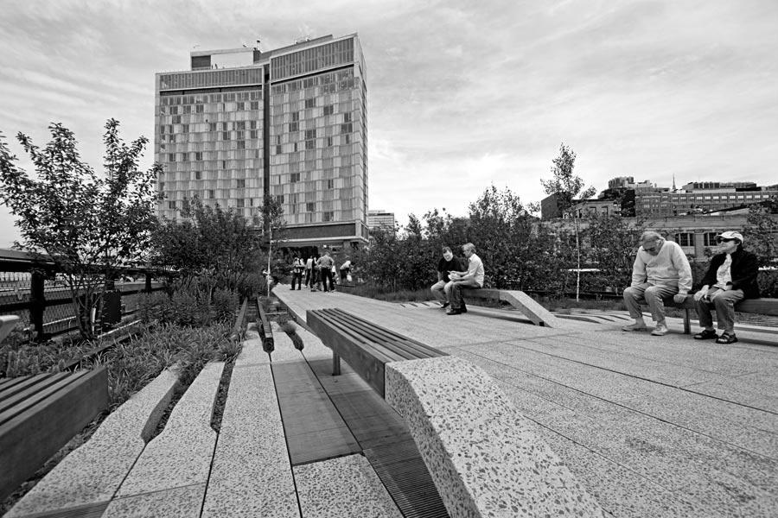
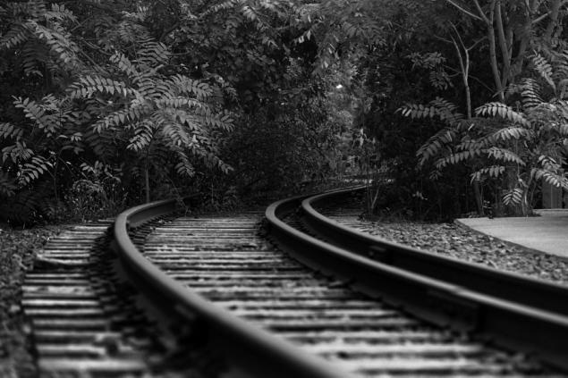
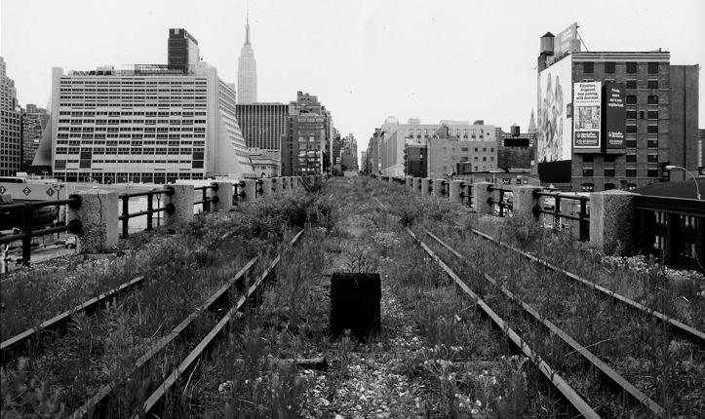
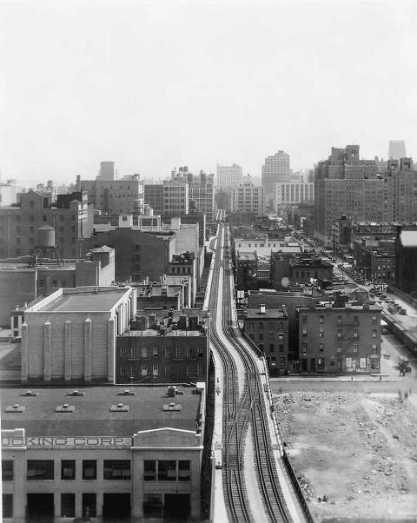
5
… special thanks to
Summary + acknowledgements + questions
4
Electrical Depth
System type conversion + Cogeneration
3
8th floor gallery
Large workspace + daylighting
2
Theater
Special purpose space
1
Building facade
Scale of perception + Exterior space
LG
Houston Museum of American Art
Project overview + design concept
Notes:
Will coverage provide flexibility?

Slide 20
5
… special thanks to
Summary + acknowledgements + questions
4
Electrical Depth
System type conversion + Cogeneration
3
8th floor gallery
Large workspace + daylighting
2
8th floor gallery
Theater
Special purpose space
1
Building facade
Scale of perception + Exterior space
LG
Houston Museum of American Art
Project overview + design concept
Notes:
The last but not least social concept studied is mentioned in Jan Gehl’s book Cities for People, that the quality of a city space is directly related to its degree of concern for the human dimension.
The social field of vision was investigated by Gehl to study the relationship between the senses, communication and dimensions. According to Gehl, our sense of sight has adapted and developed to enable us to move linearly and horizontally at a walking. Earlier in our history it was important for walkers to be able to detect dangers and enemies lurking ahead, and on the path in front of them. It was also crucial to be able to keep an eye on what was happening on both sides of the path. As a result, our eyes can see clearly and precisely straight ahead and at a great distance. Furthermore, the rods and cones in the photoreceptor layer of the eye are organized primarily horizontally, enabling use to see movement further out in the field of vision, perpendicular to the walking direction. However, our downward and upward sight has developed very differently. Looking down where it is important to see what we are stepping on, we humans can see up to 70-80 degrees below the horizon. Upwards, where in the later phases of evolutionary history we had only few enemies to beware of, the angle of vision is limited to 50-55 degrees above the horizon. Our horizontal field of visions means that when we are walking along building facades, only the ground floors can offer us interest and intensity. If ground floor facades are rich in variation and detail, our city walks will be equally rich in experience.
Since our senses and locomotors apparatus has only a limited field of upward vision, this whole account of the horizontal sensory apparatus is the key to how we experience space, for example, how much of buildings pedestrians experience when walking along streets. In general, the upper floors of tall buildings can only be seen at a distance and never close up in the cityscape.
At eye level the scene comes alive with movement and color. While the designer sees the whole building – the clean verticals, the horizontals, the way corner turns, and so on. But the museum visitors may be quite unaware of such matters. He is more apt to be looking in the other direction: not up at other buildings, but at what is going on at eye level or his handling of space.
To create a close-up experience for the visitors, a lighting approach will need to bring all the senses to bear. Every effort is made to keep the dimensions and design of outdoor space in harmony with the human scale and comfortable perception range.

Slide 21
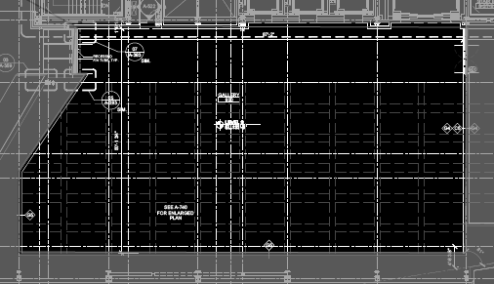
5
… special thanks to
Summary + acknowledgements + questions
4
Electrical Depth
System type conversion + Cogeneration
3
8th floor gallery
Large workspace + daylighting
N
2
Theater
Special purpose space
200 lux
1
Building facade
Scale of perception + Exterior space
LG
1 PM
2 PM
3 PM
4 PM
5 PM
6 PM
Houston Museum of American Art
Project overview + design concept
11 AM
12 PM
Notes:
The last but not least social concept studied is mentioned in Jan Gehl’s book Cities for People, that the quality of a city space is directly related to its degree of concern for the human dimension.
The social field of vision was investigated by Gehl to study the relationship between the senses, communication and dimensions. According to Gehl, our sense of sight has adapted and developed to enable us to move linearly and horizontally at a walking. Earlier in our history it was important for walkers to be able to detect dangers and enemies lurking ahead, and on the path in front of them. It was also crucial to be able to keep an eye on what was happening on both sides of the path. As a result, our eyes can see clearly and precisely straight ahead and at a great distance. Furthermore, the rods and cones in the photoreceptor layer of the eye are organized primarily horizontally, enabling use to see movement further out in the field of vision, perpendicular to the walking direction. However, our downward and upward sight has developed very differently. Looking down where it is important to see what we are stepping on, we humans can see up to 70-80 degrees below the horizon. Upwards, where in the later phases of evolutionary history we had only few enemies to beware of, the angle of vision is limited to 50-55 degrees above the horizon. Our horizontal field of visions means that when we are walking along building facades, only the ground floors can offer us interest and intensity. If ground floor facades are rich in variation and detail, our city walks will be equally rich in experience.
Since our senses and locomotors apparatus has only a limited field of upward vision, this whole account of the horizontal sensory apparatus is the key to how we experience space, for example, how much of buildings pedestrians experience when walking along streets. In general, the upper floors of tall buildings can only be seen at a distance and never close up in the cityscape.
At eye level the scene comes alive with movement and color. While the designer sees the whole building – the clean verticals, the horizontals, the way corner turns, and so on. But the museum visitors may be quite unaware of such matters. He is more apt to be looking in the other direction: not up at other buildings, but at what is going on at eye level or his handling of space.
To create a close-up experience for the visitors, a lighting approach will need to bring all the senses to bear. Every effort is made to keep the dimensions and design of outdoor space in harmony with the human scale and comfortable perception range.

Slide 22
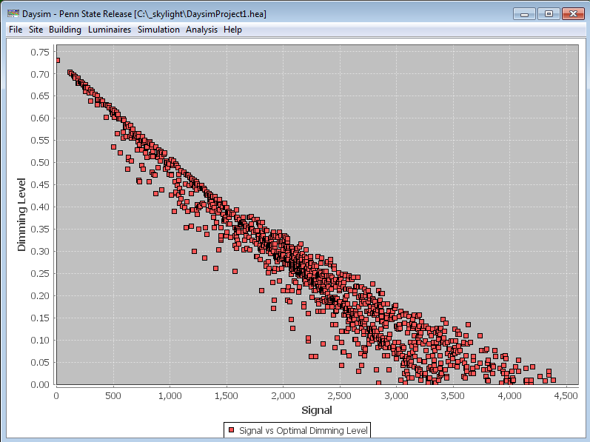
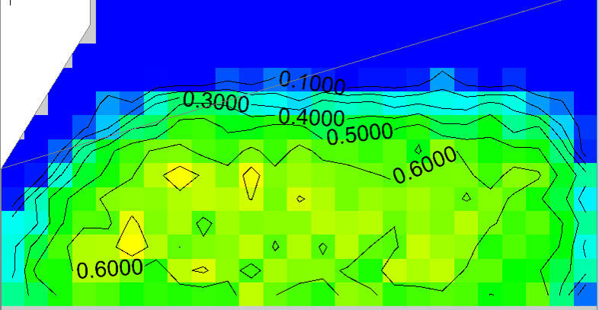
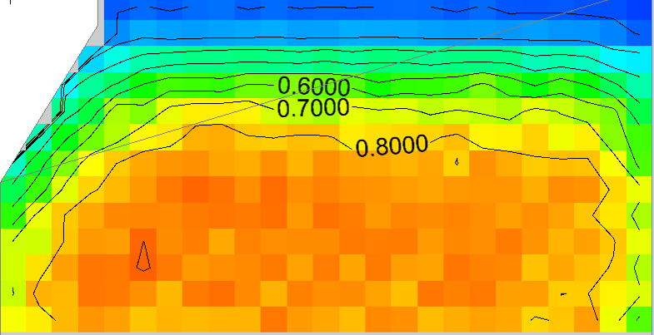
5
… special thanks to
Summary + acknowledgements + questions
Open loop
Dimming level vs. signal
4
Electrical Depth
System type conversion + Cogeneration
3
8th floor gallery
Large workspace + daylighting
N
2
Daylight autonomy 200 lux
Theater
Special purpose space
1
Building facade
Scale of perception + Exterior space
LG
Open loop sensor
Houston Museum of American Art
Project overview + design concept
Continuous daylight autonomy 200 lux
Notes:
The last but not least social concept studied is mentioned in Jan Gehl’s book Cities for People, that the quality of a city space is directly related to its degree of concern for the human dimension.
The social field of vision was investigated by Gehl to study the relationship between the senses, communication and dimensions. According to Gehl, our sense of sight has adapted and developed to enable us to move linearly and horizontally at a walking. Earlier in our history it was important for walkers to be able to detect dangers and enemies lurking ahead, and on the path in front of them. It was also crucial to be able to keep an eye on what was happening on both sides of the path. As a result, our eyes can see clearly and precisely straight ahead and at a great distance. Furthermore, the rods and cones in the photoreceptor layer of the eye are organized primarily horizontally, enabling use to see movement further out in the field of vision, perpendicular to the walking direction. However, our downward and upward sight has developed very differently. Looking down where it is important to see what we are stepping on, we humans can see up to 70-80 degrees below the horizon. Upwards, where in the later phases of evolutionary history we had only few enemies to beware of, the angle of vision is limited to 50-55 degrees above the horizon. Our horizontal field of visions means that when we are walking along building facades, only the ground floors can offer us interest and intensity. If ground floor facades are rich in variation and detail, our city walks will be equally rich in experience.
Since our senses and locomotors apparatus has only a limited field of upward vision, this whole account of the horizontal sensory apparatus is the key to how we experience space, for example, how much of buildings pedestrians experience when walking along streets. In general, the upper floors of tall buildings can only be seen at a distance and never close up in the cityscape.
At eye level the scene comes alive with movement and color. While the designer sees the whole building – the clean verticals, the horizontals, the way corner turns, and so on. But the museum visitors may be quite unaware of such matters. He is more apt to be looking in the other direction: not up at other buildings, but at what is going on at eye level or his handling of space.
To create a close-up experience for the visitors, a lighting approach will need to bring all the senses to bear. Every effort is made to keep the dimensions and design of outdoor space in harmony with the human scale and comfortable perception range.

Slide 23
5
… special thanks to
Summary + acknowledgements + questions
Open loop
Dimming level vs. signal
4
Electrical Depth
System type conversion + Cogeneration
3
8th floor gallery
Large workspace + daylighting
2
Daylight autonomy 200 lux
Theater
Special purpose space
Annual energy saving: 10, 400 kWh
1
Building facade
Scale of perception + Exterior space
LG
Houston Museum of American Art
Project overview + design concept
Continuous daylight autonomy 200 lux
Notes:
The last but not least social concept studied is mentioned in Jan Gehl’s book Cities for People, that the quality of a city space is directly related to its degree of concern for the human dimension.
The social field of vision was investigated by Gehl to study the relationship between the senses, communication and dimensions. According to Gehl, our sense of sight has adapted and developed to enable us to move linearly and horizontally at a walking. Earlier in our history it was important for walkers to be able to detect dangers and enemies lurking ahead, and on the path in front of them. It was also crucial to be able to keep an eye on what was happening on both sides of the path. As a result, our eyes can see clearly and precisely straight ahead and at a great distance. Furthermore, the rods and cones in the photoreceptor layer of the eye are organized primarily horizontally, enabling use to see movement further out in the field of vision, perpendicular to the walking direction. However, our downward and upward sight has developed very differently. Looking down where it is important to see what we are stepping on, we humans can see up to 70-80 degrees below the horizon. Upwards, where in the later phases of evolutionary history we had only few enemies to beware of, the angle of vision is limited to 50-55 degrees above the horizon. Our horizontal field of visions means that when we are walking along building facades, only the ground floors can offer us interest and intensity. If ground floor facades are rich in variation and detail, our city walks will be equally rich in experience.
Since our senses and locomotors apparatus has only a limited field of upward vision, this whole account of the horizontal sensory apparatus is the key to how we experience space, for example, how much of buildings pedestrians experience when walking along streets. In general, the upper floors of tall buildings can only be seen at a distance and never close up in the cityscape.
At eye level the scene comes alive with movement and color. While the designer sees the whole building – the clean verticals, the horizontals, the way corner turns, and so on. But the museum visitors may be quite unaware of such matters. He is more apt to be looking in the other direction: not up at other buildings, but at what is going on at eye level or his handling of space.
To create a close-up experience for the visitors, a lighting approach will need to bring all the senses to bear. Every effort is made to keep the dimensions and design of outdoor space in harmony with the human scale and comfortable perception range.

Slide 24
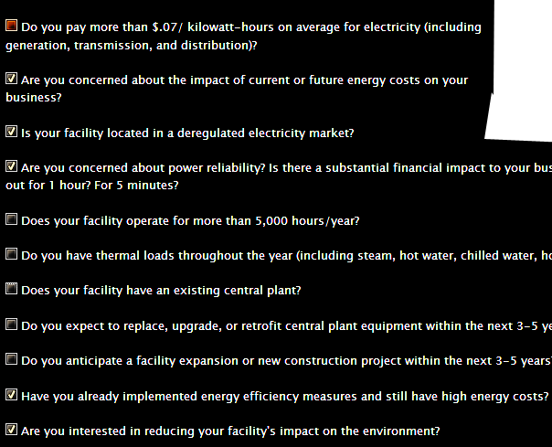
5
… special thanks to
Summary + acknowledgements + questions
4
Electrical Depth
System type conversion + Cogeneration
Energy Use | No CHP | With CHP | Difference
Annual Electricity Use
Annual Purchased Power, kWh | 3,797,626 | 1,186,142 | (2,611,484)
Annual CHP Power Generation, kWh | 0 | 2,611,484 | 2,611,484
Total Annual Electricity Use, kWh | 3,797,626 | 3,797,626 | 0
Annual Thermal Energy Use
Non-CHP Thermal Use*, MMBtu/yr | 11,818 | 591 | (11,227)
CHP Thermal Used, MMBtu/yr | 0 | 11,227 | 11,227
Total Thermal Energy Use, MMBtu/yr | 11,818 | 11,818 | 0
Annual Fuel Use
Non-CHP Thermal Fuel Use*, MMBtu/yr | 14,772 | 739 | (14,033)
CHP Fuel Use, MMBtu/yr | 0 | 25,488 | 25,488
Annual Total Fuel Use, MMBtu | 14,772 | 26,227 | 11,455
Operating Costs
Purchased Electricity | $729,144 | $277,880 | ($347,850)
Purchased Fuel | $103,995 | $301,607 | $48,109
Incremental O&M | $0 | $41,784 | $41,784
Annual Operating Costs | $833,140 | $621,270 | ($257,957)
NY policies & Incentives
Measure 1
Measure 2
3
Policy/Incentive Name | Policy/Incentive Type
Agriculture Energy Efficiency Program | Rebate
CHP Acceleration Program | Grant
Custom Measures Commercial and Industrial Rebate Program | Rebate
Energy Smart New Construction Program | Production Incentive
Existing Facilities Program | Production Incentive
FlexTech Program | Grant
Industrial and Process Efficiency Performance Incentives | Production Incentive
Linked Deposit Program (LDP) | Loan
Local Option - Solar, Wind & Biomass Energy Systems Exemption | Tax
Manufacturing Assistance Program (MAP) | Grant
National Grid (Gas) - Commercial Energy Efficiency Rebate Programs (Metro NY) | Rebate
National Grid (Gas) - Commercial Energy Efficiency Rebate Programs (Upstate NY) | Rebate
New York Natural Gas Rates | Utility Rate
Tax-Exempt Equipment Leasing Program (TELP) | Tax
Facility Energy Use*
Facility Average Electric Demand, kW | 1,826
Facility Average Heating, MMBtu/hour | 5.7
CHP system information
CHP System Type | Recip Engine
CHP System Capacity, kW | 1,322
CHP Electric Efficiency | 35.0%
CHP Thermal Output, Btu/kWh | 4,299
CHP Thermal Output, MMBtu/hour | 5.7
CHP System Fuel Cost (Natural Gas), $/MMBtu | $4.2
CHP Installed Cost, $/kW | $2,300
CHP O&M Cost, cents/kWh | $0.0160
CHP Cost to Generate Power
Operating Cost to Generate
CHP Fuel Costs, $/kWh | $0.0410
Thermal Credit, $/kWh | ($0.0226)
Incremental O&M, $/kWh | $0.0344
Operating Costs to Generate Power, $/kWh | $0.1209
Capital Charge, $/kWh | $0.1553
Total Costs to Generate Power, $/kWh | $0.1480
Current Average Electricity Price, $/kWh | $0.1920
Spark Spread, $/kWh** | ($0.0073)
8th floor gallery
Large workspace + daylighting
2
Theater
Special purpose space
Annual operating savings: $ 257,957
1
Building facade
Scale of perception + Exterior space
LG
Houston Museum of American Art
Project overview + design concept

Slide 25
5
… special thanks to
Summary + acknowledgements + questions
4
Electrical Depth
System type conversion + Cogeneration
 | Load (kVA) | ampere | Growth | Existing Size phase legs | New Size phase legs
DS-1#3 | 87 | 104.7 | 130.9 | 600KCMIL | (1) 1/0
DS-1#4 | 89.7 | 107.9 | 134.9 | 600KCMIL | (1) 1/0
DS-1#5 | 116.5 | 140.2 | 175.2 | (2) 600KCMIL | (1) 3/0
DS-1#6 | 55.9 | 67.3 | 84.1 | (2) 250KCMIL | 4
DS-1#7 | 105.6 | 127.1 | 158.8 | (5) 600KCMIL | (1) 2/0
DS-2#2 | 108.3 | 130.3 | 162.9 | 600KCMIL | (1) 2/0
DS-2#3 | 120.9 | 145.5 | 181.9 | (2) 4/0 | (1) 3/0
DS-2#5 | 114.4 | 137.7 | 172.1 | 600KCMIL | (1) 2/0
DS-2#7 | 75.4 | 90.7 | 113.4 | 600KCMIL | 2
DS-2#8 | 89.7 | 107.9 | 134.9 | (2) 300KCML | (1) 1/0
DS-2#9 | 116.5 | 140.2 | 175.2 | (2) 300KCML | (1) 2/0
3
8th floor gallery
Large workspace + daylighting
2
Theater
Special purpose space
material and installation savings: $ 85,200
1
Building facade
Scale of perception + Exterior space
LG
Houston Museum of American Art
Project overview + design concept
$101,700
$16,500

Slide 26
5
… special thanks to
Summary + acknowledgements + questions
Summary
Acknowledgements
4
Electrical Depth
System type conversion + Cogeneration
Lighting redesign approached from social, functional, and aesthetics aspects and successfully achieve the overall concept of “engaging”.
Daylighting analysis proved that daylight integration of the space helps to reduce the energy cost as well as to reinforce the positive psychological impacts of daylighting, and at the same time provide different lighting variations for artworks viewing
Cogeneration feasibility analysis set the first step to establish a successful combined heat and power system and to install a reliable energy source for the project. Electrical system type conversion based on the CHP implementation will greatly reduce the cost associated.
I would like to thank the many individuals who made this thesis possible.
Ben Gordon | Engineer, Turner Construction
Jean Sundin | Principal, OVI
Enrique Peiniger | Principal, OVI
Shawn Good | Lighting Department Head, Brinjac Engineering
Sandra Stashik | Marketing Manager, Acuity Brands Lighting
Dr. Richard Mistrick | Honors Advisor, AE Lighting Associate Professor, Penn State
Dr. Kevin Houser | Thesis Advisor, AE Lighting Professor, Penn State
Leslie Beahm | Electrical Advisor, Reese Engineering
Family and friends for their support
3
8th floor gallery
Large workspace + daylighting
2
Theater
Special purpose space
1
Building facade
Scale of perception + Exterior space
LG
Houston Museum of American Art
Project overview + design concept

Slide 27
5
… special thanks to
Summary + acknowledgements + questions
4
Electrical Depth
System type conversion + Cogeneration
3
8th floor gallery
Large workspace + daylighting
We hope you enjoyed your visit.
Question and Answer
2
Theater
Special purpose space
1
Building facade
Scale of perception + Exterior space
LG
Houston Museum of American Art
Project overview + design concept

Slide 28
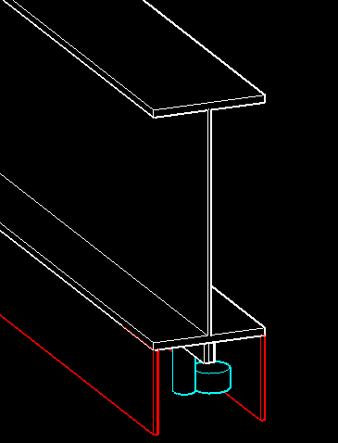
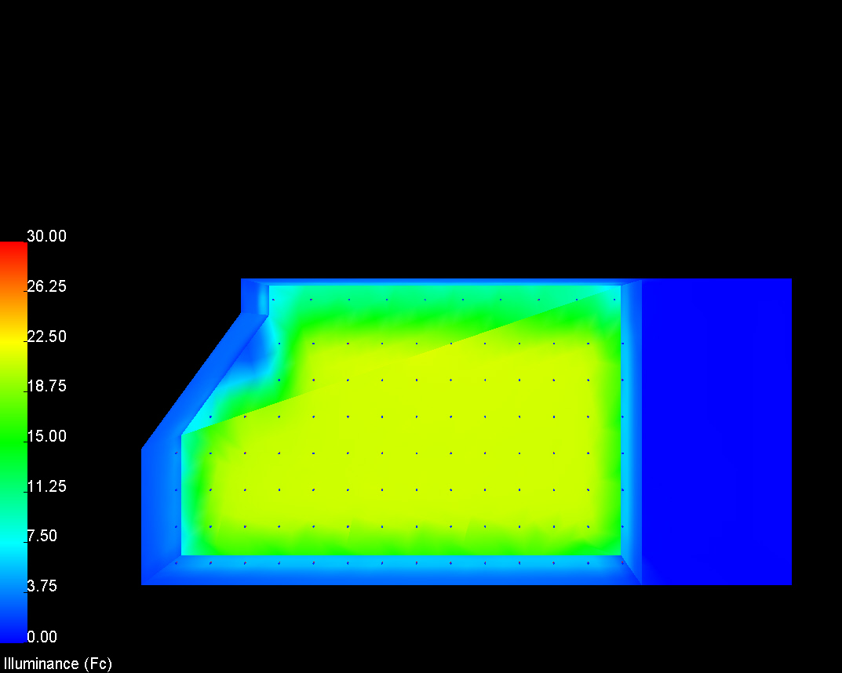
6
Appendix
… special thanks to
Summary + acknowledgements + questions
5
Electrical Depth
System type conversion + Cogeneration
4
8th floor gallery
Large workspace + daylighting
3
8th floor gallery
Theater
Special purpose space
L.F. Raceway * no. of conductor)x 1.1/100 = C.F.L.
1
Building facade
Scale of perception + Exterior space
LG
Houston Museum of American Art
Project overview + design concept
Critical Point Condition

Slide 29
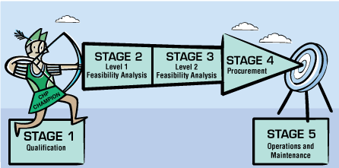
6
Appendix
… special thanks to
Summary + acknowledgements + questions
5
Electrical Depth
System type conversion + Cogeneration
 | Load (kVA) | ampere | Growth | Existing Size | New Size | L.F. Raceway | Original Cost | New cost
 |  |  |  | phase legs | phase legs
DS-1#3 | 87 | 104.7 | 130.9 | 600KCMIL | (1) 1/0 | 230 | 5,123.25 | 1,189.10
DS-1#4 | 89.7 | 107.9 | 134.9 | 600KCMIL | (1) 1/0 | 244 | 5,435.10 | 1,261.48
DS-1#5 | 116.5 | 140.2 | 175.2 | (2) 600KCMIL | (1) 3/0 | 290 | 12,919.50 | 2,217.05
DS-1#6 | 55.9 | 67.3 | 84.1 | (2) 250KCMIL | 4 | 328 | 7,071.68 | 840.66
DS-1#7 | 105.6 | 127.1 | 158.8 | (5) 600KCMIL | (1) 2/0 | 328 | 36,531.00 | 2,056.56
DS-2#2 | 108.3 | 130.3 | 162.9 | 600KCMIL | (1) 2/0 | 244 | 5,435.10 | 1,529.88
DS-2#3 | 120.9 | 145.5 | 181.9 | (2) 4/0 | (1) 3/0 | 244 | 4,509.12 | 1,865.38
DS-2#5 | 114.4 | 137.7 | 172.1 | 600KCMIL | (1) 2/0 | 313 | 6,972.08 | 1,962.51
DS-2#7 | 75.4 | 90.7 | 113.4 | 600KCMIL | 2 | 201 | 4,477.28 | 515.16
DS-2#8 | 89.7 | 107.9 | 134.9 | (2) 300KCML | (1) 1/0 | 244 | 6,039.00 | 1,261.48
DS-2#9 | 116.5 | 140.2 | 175.2 | (2) 300KCML | (1) 2/0 | 291 | 7,202.25 | 1,824.57
 |  |  |  |  |  |  | 101,715.35 | 16,523.84 | 85,191.51
4
8th floor gallery
Large workspace + daylighting
3
Theater
Special purpose space
1
Building facade
Scale of perception + Exterior space
LG
Houston Museum of American Art
Project overview + design concept

Slide 30
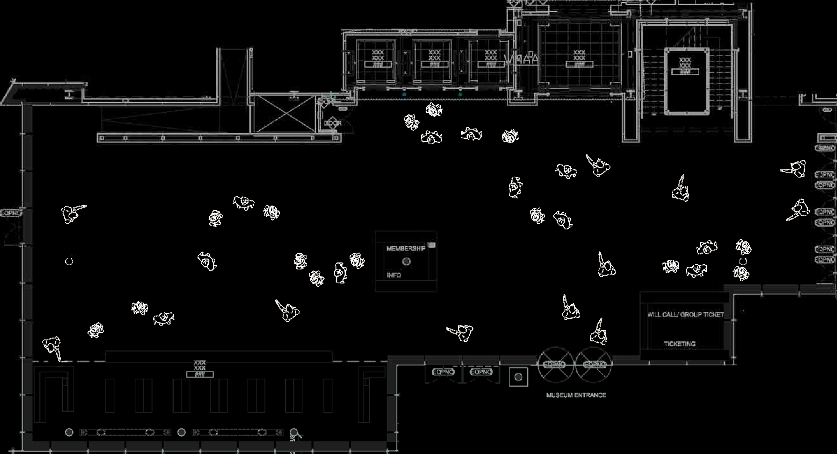
6
Appendix
… special thanks to
Summary + acknowledgements + questions
Space Type | E_{v}
Building Façade | Lighter-toned façade materials (Reflectance ≥0.5), 200 lux ; Darker-toned façade materials (Reflectance <0.5), 400 lux
5
Electrical Depth
System type conversion + Cogeneration
4
Space Type | Power Density (W/sqf) | Note
Building Façade | 0.2 W/ft² for each illuminated wall or surface or 5.0 W/linear foot for each illuminated wall or surface length | Tradable
Building Grounds | 1.0 W/linear foot for walkways less than 10 ft wide. 0.2 W/ft² for walkway 10 ft wide or greater, plaza areas, and special feature areas | Nontradable
Canopies | 1.25 W/ft² | Tradable
8th floor gallery
Large workspace + daylighting
3
Theater
Special purpose space
Space Type | E_{h} | E_{v} | Avg:Min
Audience Seating - During production | 2 lux @ floor | 1 lux @ 5ft AFF | 2 : 1
Audience Seating - pre/post production and during intermissions | 100 lux @ floor | 30 lux @ 5ft AFF | 2 : 1
Circulation - During production | 2 lux @ floor | 4 lux @ 5ft AFF | 5 : 1
Circulation - pre/post production and during intermissions | 100 lux @ floor | 30 lux @ 5ft AFF | 2 : 1
1
Building facade
Scale of perception + Exterior space
LG
Houston Museum of American Art
Project overview + design concept
Space Type | Power Density (W/sqf)
Audience/Seating Area for Performing Arts Theater | 2.6 W/ft²

Slide 31
6
Appendix
… special thanks to
Summary + acknowledgements + questions
Space Type | E_{h} | E_{v} | Avg:Min
Object with low sensitivity to light | 200 lux @ floor | 200lux @ 5ft AFF | 2:1
Circulation/general | Avg=0.2 times object Eh but with min>10lx | Avg of 0.2 times object Ev | 4:1
5
Electrical Depth
System type conversion + Cogeneration
4
Space Type | Power Density (W/sqf)
Gallery | 1.02 W/ft²
8th floor gallery
Large workspace + daylighting
3
Theater
Special purpose space
1
Building facade
Scale of perception + Exterior space
LG
Houston Museum of American Art
Project overview + design concept

